Slide 1
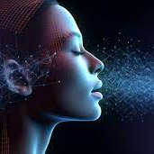
Combined AI voice assistant hybrid app

Slide 2
Problem statements
Voice assistants - not being greatly supported by the modern AI
Voice assistants - only restricted to very minimal devices
Even if a modern AI is stitched along with a Voice assistant, we will be restricted with only that choice alone

Slide 3
Solution
In addition to commands the VA should be integratable with Modern AI
Making VA as a hybrid app - Any time & Any platform
Multiple AI should be integratable.

Slide 4
Hybrid app – Solution & Tech Stack
Electron JS – MAC & Windows desktop app
Next JS – powered by ReactJS and helps websites to have SEO
DEMO

Slide 5

Q & A

